Slide 1
Find a place to open a fast-food restaurant
Kwai Leung
09/28/2020

Slide 2
Problem
A customer wants to open a fast-food restaurant in Maryland, US. Therefore, they want us to help them to find the best location for the restaurant.

Slide 3
Location Criteria
Find a city with high population – At least 45,000 population in the city.
The city has low proportion of fast-food restaurant per people.
The location must meet both criteria above.

Slide 4
Data Acquisition
United State Zip Code Organization – Latitude, Longitude, and Estimated population data in US.
Foursquare – Location and Surrounding restaurant data.

Slide 5
Data Cleaning
We need Maryland data only.
The city population must equal or greater than 45,000.
No PO Box address.
Merge both data from United State Zip Code Organization and Foursquare into one data set for analysis.

Slide 6
Methodology/exploratory data analysis
Use k-means clustering.
First analysis – set kclusters = 5.
Second analysis – set kclusters = 7.

Slide 7
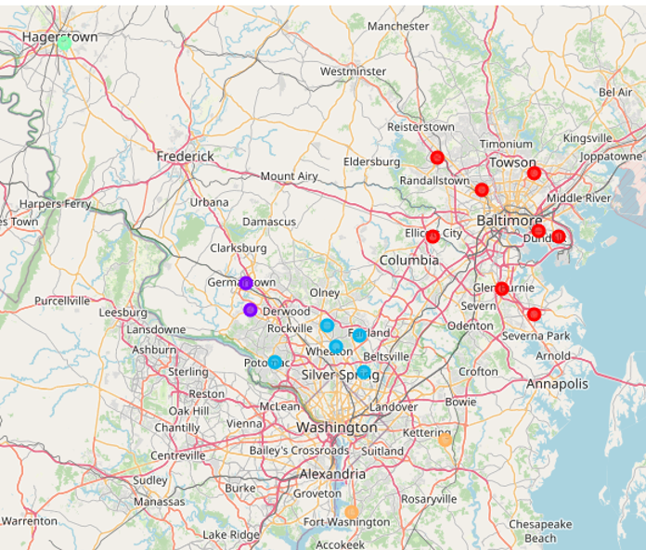
Map for first analysis

Slide 8
Number of restaurants and ratio
Cluster | Total Population | Number of fast-food restaurants | Ratio of fast-food restaurant and population
1 | 412010 | 473 | 871
2 | 122230 | 100 | 1222
3 | 273950 | 271 | 1010
4 | 52380 | 39 | 1343
5 | 95950 | 103 | 931
Cluster 4 has highest ratio of fast-food restaurant and population.

Slide 9
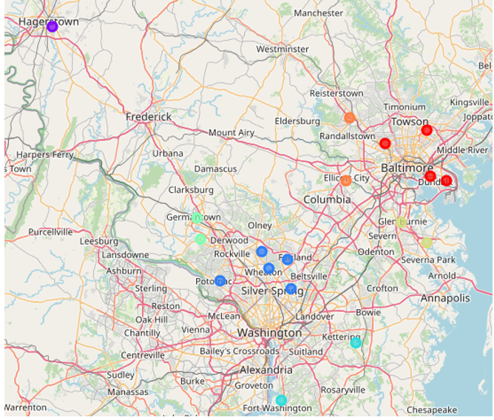
Map for second analysis

Slide 10
Number of restaurants and ratio
Cluster | Total Population | Number of fast-food restaurants | Ratio of fast-food restaurant and population
1 | 205470 | 245 | 838
2 | 52380 | 39 | 1343
3 | 273950 | 271 | 1010
4 | 95950 | 103 | 931
5 | 122230 | 100 | 1222
6 | 108710 | 113 | 962
7 | 97830 | 115 | 850
Cluster 2 has highest ratio of fast-food restaurant and population.

Slide 11
Result/Conclusions
First Analysis – Cluster 4 has highest ratio of fast-food restaurant and population.
Second Analysis – Cluster 2 has highest ratio of fast-food restaurant and population.
* First Choose *
Both Cluster 4 & 2 are the same city – Hagerstown, Maryland
* Second Choose *
Gaithersburg or Germantown

Slide 12
Future directions
Add additional data such as average income, median income, and sales in restaurant of each city.
Use different data science methods and algorithms to do further analysis.
Other factors will affect the business, such as business model, local economy, and global event (COVID-19).

